Slide 1

Exploratory Data Analysis
Cab Industry Investment Analysis and Recommendations
Hassan Eisa
Friday, 21st of June 2024

Slide 2
Agenda
Introduction
Data Analysis
Profit Analysis
Customer Demographics
Seasonal Trends
Recommendations
Conclusion

Slide 3
Introduction
The analysis was conducted to evaluate the performance of two cab companies, Yellow Cab and Pink Cab, to determine which company is a better investment opportunity for XYZ. The analysis included:
Loading and preparing the dataset, which contains customer demographics, transaction details, and trip information.
Analyzing overall and yearly profits for both companies.
Examining customer demographics such as gender, age, and income distribution.
Assessing customer retention rates.
Evaluating geographical reach and performance across different cities.
Identifying seasonal trends in demand and profitability.

Slide 4
Introduction
Objectives:
Profit Comparison: Determine which company generates higher overall and yearly profits.
Customer Insights: Analyze the demographics of the customer base for both companies.
Retention Rates: Evaluate which company has better customer retention.
Geographical Analysis: Compare the market reach and performance in various cities.
Seasonal Trends: Identify patterns in demand and profitability across different times of the year.
Investment Recommendation: Based on the analysis, recommend the better investment opportunity for XYZ, and provide strategic improvement suggestions for the other company.

Slide 5
Data Analysis
Loading & Preparing Data:
The dataset includes customer demographics, transaction details, and trip information.
Loading the Data:
Used the ‘load_csv’ function to load a CSV file into a Pandas DataFrame.
It handles errors such as file not found, empty file, and other unexpected errors.
The dataset is loaded using the ‘pd.read_csv()’ function, and a preview of the data is printed using ‘data.head()’.
Preparing the Data:
The ‘Date of Travel’ column is converted to datetime format using ‘pd.to_datetime()’.
Missing values are removed with ‘data.dropna(inplace=True)’.
A new column ‘Age_Group’ is created based on the ‘Age’ column using the ‘categorize_age’ function, which categorizes age into groups: ‘<18’, ‘18-35’, ‘36-50’, and ‘50+’.
The first few rows of the cleaned and prepared data are displayed using ‘data.head()’.

Slide 6
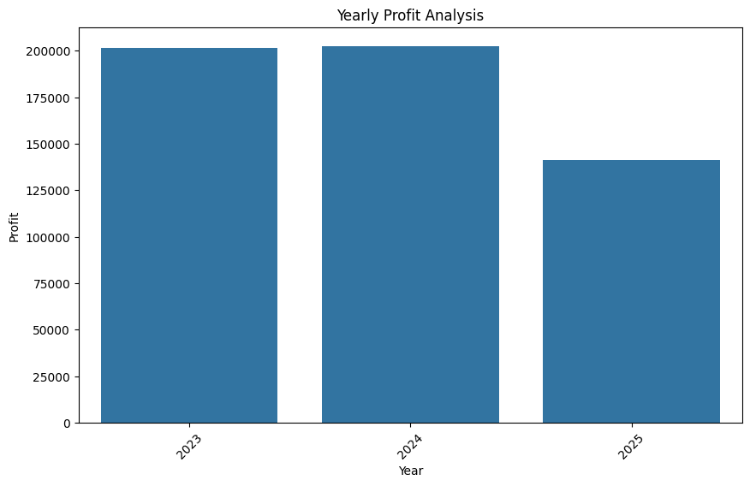
Profit Analysis

Slide 7
Customer Demographics
The customer demographics analysis focuses on understanding the characteristics of the customer base for Yellow Cab and Pink Cab.
Key attributes analyzed include gender, age, and income class distributions.
Performed a:
Profit Analysis by Gender
Profit Analysis by Income Class
Profit Analysis by Age Group
Age Group-wise Customer Reach

Slide 8
Customer Demographics
Code Snippets (Python) :
Gender Analysis:
import pandas as pd
import matplotlib.pyplot as plt
# Assuming data is already loaded into a DataFrame called 'df'
# Gender distribution
gender_counts = df['Gender'].value_counts()
# Plotting gender distribution
plt.figure(figsize=(8, 6))
gender_counts.plot(kind='bar', color=['blue', 'pink'])
plt.title('Customer Gender Distribution')
plt.xlabel('Gender')
plt.ylabel('Number of Customers')
plt.show()

Slide 9
Customer Demographics
Code Snippets (Python) :
Income Class Analysis:
# Assuming income classes are categorized in the 'Income Class' column
# Income class distribution
income_class_counts = df['Income Class'].value_counts()
# Plotting income class distribution
plt.figure(figsize=(8, 6))
income_class_counts.plot(kind='bar', color='green')
plt.title('Customer Income Class Distribution')
plt.xlabel('Income Class')
plt.ylabel('Number of Customers')
plt.show()

Slide 10
Customer Demographics
Code Snippets (Python) :
Age Group Analysis:
# Creating age groups
bins = [0, 18, 35, 50, 100]
labels = ['<18', '18-35', '36-50', '50+']
df['Age Group'] = pd.cut(df['Age'], bins=bins, labels=labels)
# Age group distribution
age_group_counts = df['Age Group'].value_counts()
# Plotting age group distribution
plt.figure(figsize=(8, 6))
age_group_counts.plot(kind='bar', color='purple')
plt.title('Customer Age Group Distribution')
plt.xlabel('Age Group')
plt.ylabel('Number of Customers')
plt.show()

Slide 11
Customer Demographics
Code Snippets (Python) :
Age Group-wise Customer Reach:
# Assuming customer reach is measured in terms of number of rides or some other metric
# Age group customer reach (e.g., number of rides per age group)
age_group_reach = df.groupby('Age Group')['Number of Rides'].sum()
# Plotting age group customer reach
plt.figure(figsize=(8, 6))
age_group_reach.plot(kind='bar', color='orange')
plt.title('Customer Reach by Age Group')
plt.xlabel('Age Group')
plt.ylabel('Number of Rides')
plt.show()

Slide 12
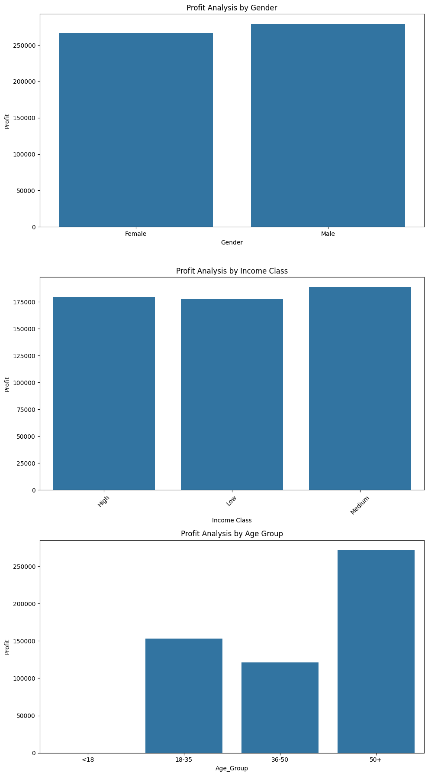
Customer Demographics

Slide 13
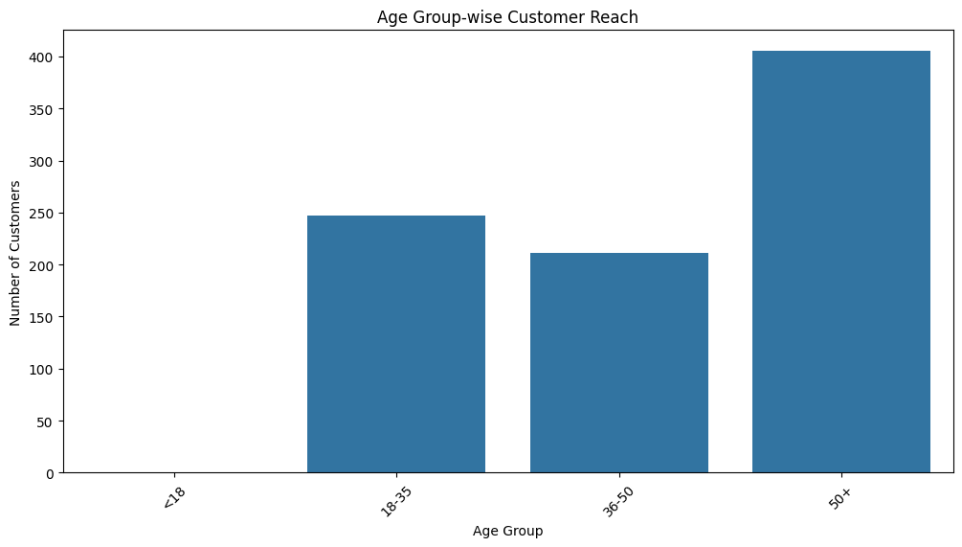
Customer Demographics

Slide 14
Seasonal Trends
The seasonal trends analysis aims to uncover patterns in customer demand and profitability over different time periods, such as days of the week and months of the year.
Additionally, forecasting future profits based on historical data is a key part of this analysis.
Day-wise Demand Analysis:
Analyze customer demand on different days of the week to identify peak and off-peak days.
Month-wise Profit Analysis:
Analyze the monthly profit trends to understand seasonality in profitability.
Profit Forecast for 2019:
Forecast profits for the year 2019 based on historical data using a time series forecasting method.

Slide 15
Seasonal Trends
Code Snippets (Python):
Day-wise Demand Analysis:
import pandas as pd
import matplotlib.pyplot as plt
# Assuming data is already loaded into a DataFrame called 'df'
# Convert the date column to datetime format
df['Date of Travel'] = pd.to_datetime(df['Date of Travel'])
# Extract the day of the week
df['Day of Week'] = df['Date of Travel'].dt.day_name()
# Calculate the number of rides per day of the week
day_demand = df['Day of Week'].value_counts().sort_index()
# Plotting the day-wise demand
plt.figure(figsize=(10, 6))
day_demand.plot(kind='bar', color='skyblue')
plt.title('Day-wise Demand Analysis')
plt.xlabel('Day of the Week')
plt.ylabel('Number of Rides')
plt.show()

Slide 16
Seasonal Trends
Code Snippets (Python):
Month-wise Profit Analysis:
# Extract the month from the date
df['Month'] = df['Date of Travel'].dt.month_name()
# Calculate the total profit per month
monthly_profit = df.groupby('Month')['Profit'].sum()
# Reorder the months for proper visualization
months_order = ['January', 'February', 'March', 'April', 'May', 'June',
'July', 'August', 'September', 'October', 'November', 'December']
monthly_profit = monthly_profit.reindex(months_order)
# Plotting the month-wise profit
plt.figure(figsize=(12, 6))
monthly_profit.plot(kind='bar', color='lightgreen')
plt.title('Month-wise Profit Analysis')
plt.xlabel('Month')
plt.ylabel('Total Profit')
plt.show()

Slide 17
Seasonal Trends
Code Snippets (Python):
Profit Forecast for 2019:
import pandas as pd
import matplotlib.pyplot as plt
from statsmodels.tsa.holtwinters import ExponentialSmoothing
# Assuming data is already loaded into a DataFrame called 'df'
# Convert the date column to datetime format and set it as index
df['Date of Travel'] = pd.to_datetime(df['Date of Travel'])
df.set_index('Date of Travel', inplace=True)
# Resample the data to monthly frequency and calculate monthly profit
monthly_profit = df['Profit'].resample('M').sum()
# Fit the Holt-Winters Exponential Smoothing model
model = ExponentialSmoothing(monthly_profit, seasonal='add', seasonal_periods=12)
fit = model.fit()
# Forecast for the next 12 months (2019)
forecast = fit.forecast(12)
# Plotting the actual and forecasted profits
plt.figure(figsize=(12, 6))
monthly_profit.plot(label='Actual Profit')
forecast.plot(label='Forecasted Profit', linestyle='--')
plt.title('Profit Forecast for 2019')
plt.xlabel('Date')
plt.ylabel('Profit')
plt.legend()
plt.show()

Slide 18
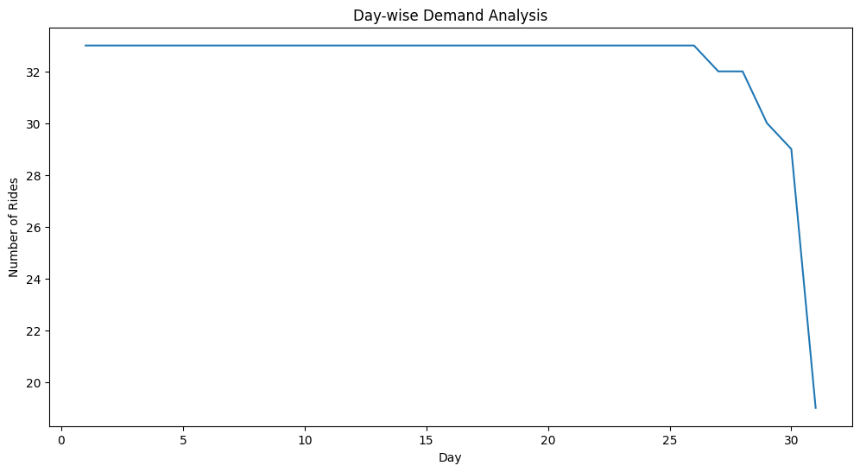
Seasonal Trends

Slide 19
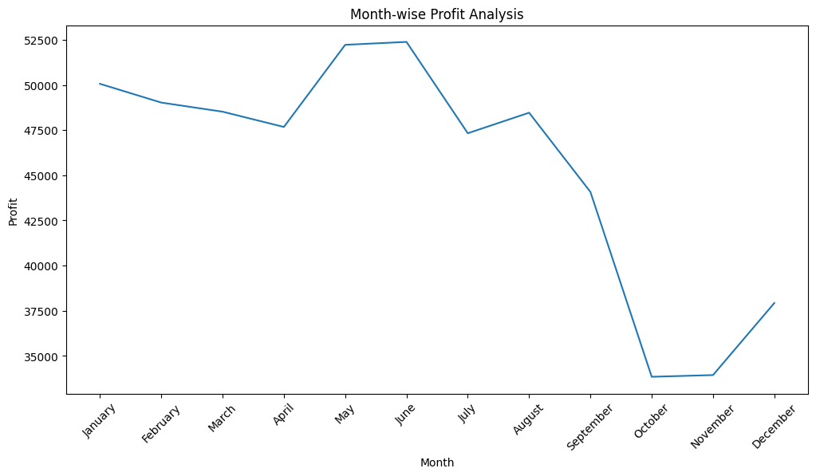
Seasonal Trends

Slide 20
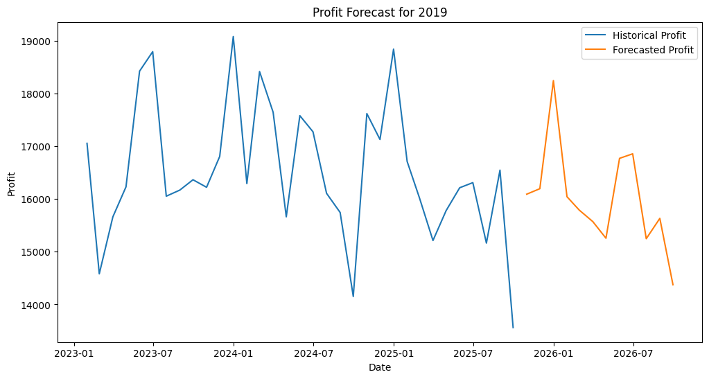
Seasonal Trends

Slide 21
Recommendations
Investment Recommendation:
Yellow Cab:
Based on the analysis, Yellow Cab shows a consistent upward trend in profitability, a diverse and balanced customer demographic, and a strong market presence across various regions. These factors make Yellow Cab a more stable and promising investment opportunity.

Slide 22
Recommendations
Strategic Improvements for Pink Cab:
Market Penetration:
Focus on increasing market penetration in regions where Yellow Cab has a stronger presence. Tailored marketing strategies and promotions could help capture a larger market share.
Customer Retention:
Implement loyalty programs and customer satisfaction initiatives to improve retention rates. Understanding and addressing the reasons for customer churn can help retain a larger customer base.
Seasonal Promotions:
Utilize the insights from seasonal trends to introduce targeted promotions during peak demand periods and off-peak discounts to boost usage and profitability.

Slide 23
Conclusion
Yellow Cab is recommended for investment due to its consistent performance and strong market positioning.
Pink Cab can improve its competitiveness with targeted strategic initiatives aimed at market expansion and customer retention.

Slide 24
END OF PRESENTATION
Thank You
Hassan Eisa

